Slide 1

Lecture 3 Arrays
Computer Engineering/Basic Computer Engineering

Slide 2
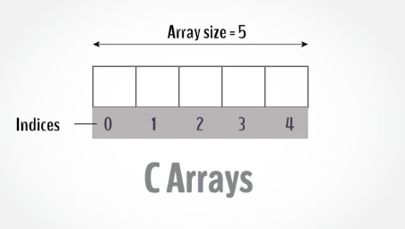
Arrays
An array is a variable that can store multiple values. For example, if you want to store 100 integers, you can create an array for it.
Compared to the basic data type (int, float) it is an aggregate or derived data type.

Slide 3
Arrays
Why need to use array type?
Consider the following issue:
"We have a list of 1000 students' marks of an integer type. If using the basic data type (int), we will declare something like the following…"
int studMark0, studMark1, ...studMark999

Slide 4
Arrays
Can you imagine how long we have to write the declaration part by using normal variable declaration?
int main(void)
{
int studMark1, studMark2, studMark3, studMark4, …, …, studMark998, stuMark999, studMark1000;
…
…
return 0;
}

Slide 5
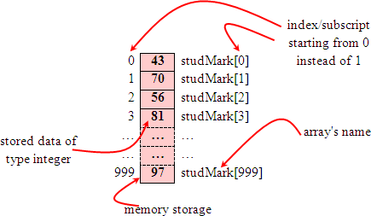
Arrays
By using an array, we just declare like this,
int studMark[1000];
Int data [100];
This will reserve 1000 contiguous memory locations for storing the students’ marks.
Graphically, this can be depicted as in the following figure.

Slide 6
Declaration of Arrays
A single or one dimensional array declaration has the following form,
dataType arrayName[arraySize];
Example:
float mark[5];
Here, we declared an array, mark, of floating-point type. And its size is 5. Meaning, it can hold 5 floating-point values.
It's important to note that the size and type of an array cannot be changed once it is declared.

Slide 7
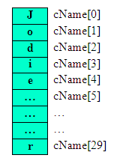
Access Arrays Element
For example, to declare an array of 30 characters, that construct a people name, we could declare,
char cName[30];
In this statement, the array character can store up to 30 characters with the first character occupying location cName[0] and the last character occupying cName[29].
Note that the index runs from 0 to 29. In C, an index always starts from 0 and ends with array's (size-1).
So, take note the difference between the array size and subscript/index terms.

Slide 8

Access Arrays Element
Suppose you declared an array mark as above. The first element is mark[0], the second element is mark[1] and so on.
float mark[5];
Arrays have 0 as the first index, not 1. In this example, mark[0] is the first element.
If the size of an array is n, to access the last element, the n-1 index is used. In this example, mark[4]
Suppose the starting address of mark[0] is 2120d. Then, the address of the mark[1] will be 2124d. Similarly, the address of mark[2] will be 2128d and so on. This is because the size of a float is 4 bytes.

Slide 9
Access Arrays Element
An array may be initialized at the time of declaration.
Initialization of an array may take the following form,
type array_name[size] = {a_list_of_value};
Data Type | Initialization
int | idNUM[7] ={1,2,3,4,5,6,7};
 | int mark[5]= {20, 23, 25, 16, 18}; OR int mark[ ]= {20, 23, 25, 16, 18};
float | fFloatNum[5]={5.6, 5.7, 5.8, 5.9, 6.1};
char | chVowel[5]={‘a’, ’e’ , ’i’, ’o’, ’u’}

Slide 10
Retrieving Array Elements
If you want to retrieve specific element, then you have to specify not only the array or variable name but also the index number of interest.
For example:
int Arr[ ]={1,3,5,6,8};
printf(“%d\t%d\n”,Arr[1],Arr[2]);

Slide 11
Change Value of Array elements
int mark[5] = {19, 10, 8, 17, 9}
// make the value of the third element to -1
mark[2] = -1;
// make the value of the fifth element to 0
mark[4] = 0;

Slide 12
Input and Output Array Elements
Here's how you can take input from the user and store it in an array element.
// take input and store it in the 3rd element
​scanf("%d", &mark[2]);
// take input and store it in the ith element
scanf("%d", &mark[i-1]);

Slide 13
Input and Output Array Elements
Here's how you can print an individual element of an array.
// print the first element of the array
printf("%d", mark[0]);
// print the third element of the array
printf("%d", mark[2]);
// print ith element of the array
printf("%d", mark[i-1]);

Slide 14

Exercise 1
What is the output ?
// Program to take 3 values from the user and store them in an array
// Print the elements stored in the array
#include <stdio.h>
int main()
{
int values[3];
printf("Enter 3 integers: ");
// taking input and storing it in an array
for(int i = 0; i < 3; ++i)
{
scanf("%d", &values[i]);
}
printf("Displaying integers: ");
// printing elements of an array
for(int i = 0; i < 3; ++i)
{
printf("%d\n",values[i]);
}
return 0;
}

Slide 15
Exercise 2
Take 10 integer input from user and store them in an array and find the sum of all numbers stored in array.
#include<stdio.h>
int main()
{
int i,sum=0,arr[10];
for(i=0;i<10;i++)
{
printf("Enter an integers %d\n",i); /i+1
scanf(“%d”,&arr[i]);
sum+=arr[i];
}
printf("Sum of input integers is %d\n",sum);
return 0;
}
What is the output ?

Slide 16
Exercise 3
// Program to find the average of n numbers using arrays
#include <stdio.h>
int main()
{
int marks[5], i, n, sum = 0;
double average;
printf("Enter number of elements: ");
scanf("%d", &n);
for(i=0; i < n; ++i)
{
printf("Enter number%d: ",i+1);
scanf("%d", &marks[i]);
// adding integers entered by the user to the sum variable
sum += marks[i];
}
// explicitly convert sum to double
// then calculate average
average = (double) sum / n;
printf("Average = %.2lf", average);
return 0;
}
What is the output ?

Slide 17
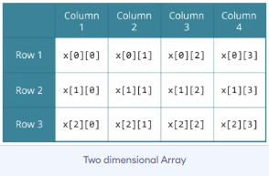
Multidimensional Array
In C programming, you can create an array of arrays. These arrays are known as multidimensional arrays. For example,
float x[3][4];
Here, x is a two-dimensional (2d) array. The array can hold 12 elements. You can think the array as a table with 3 rows and each row has 4 columns.

Slide 18
Multidimensional Array
Similarly, you can declare a three-dimensional (3d) array. For example:
float y[2][4][3];
Here, the array y can hold 24 elements.

Slide 19
Initializing of a 2d Array
// Different ways to initialize two-dimensional array
int c[2][3] = {{1, 3, 0}, {-1, 5, 9}};
int c[][3] = {{1, 3, 0}, {-1, 5, 9}};
int c[2][3] = {1, 3, 0, -1, 5, 9};

Slide 20
Initializing of a 3d Array
You can initialize a three-dimensional array in a similar way to a two-dimensional array. Here's an example,
int test[2][3][4] = {{{3, 4, 2, 3}, {0, -3, 9, 11}, {23, 12, 23, 2}},
{{13, 4, 56, 3}, {5, 9, 3, 5}, {3, 1, 4, 9}}};

Slide 21
Example 1: Two-dimensional Array to store and print values
https://www.programiz.com/c-programming/online-compiler/?ref=008a1ec2
Example 2: Sum of two matrices
https://www.programiz.com/c-programming/online-compiler/?ref=6d9edf35

Slide 22
THANK YOU

